Slide 1
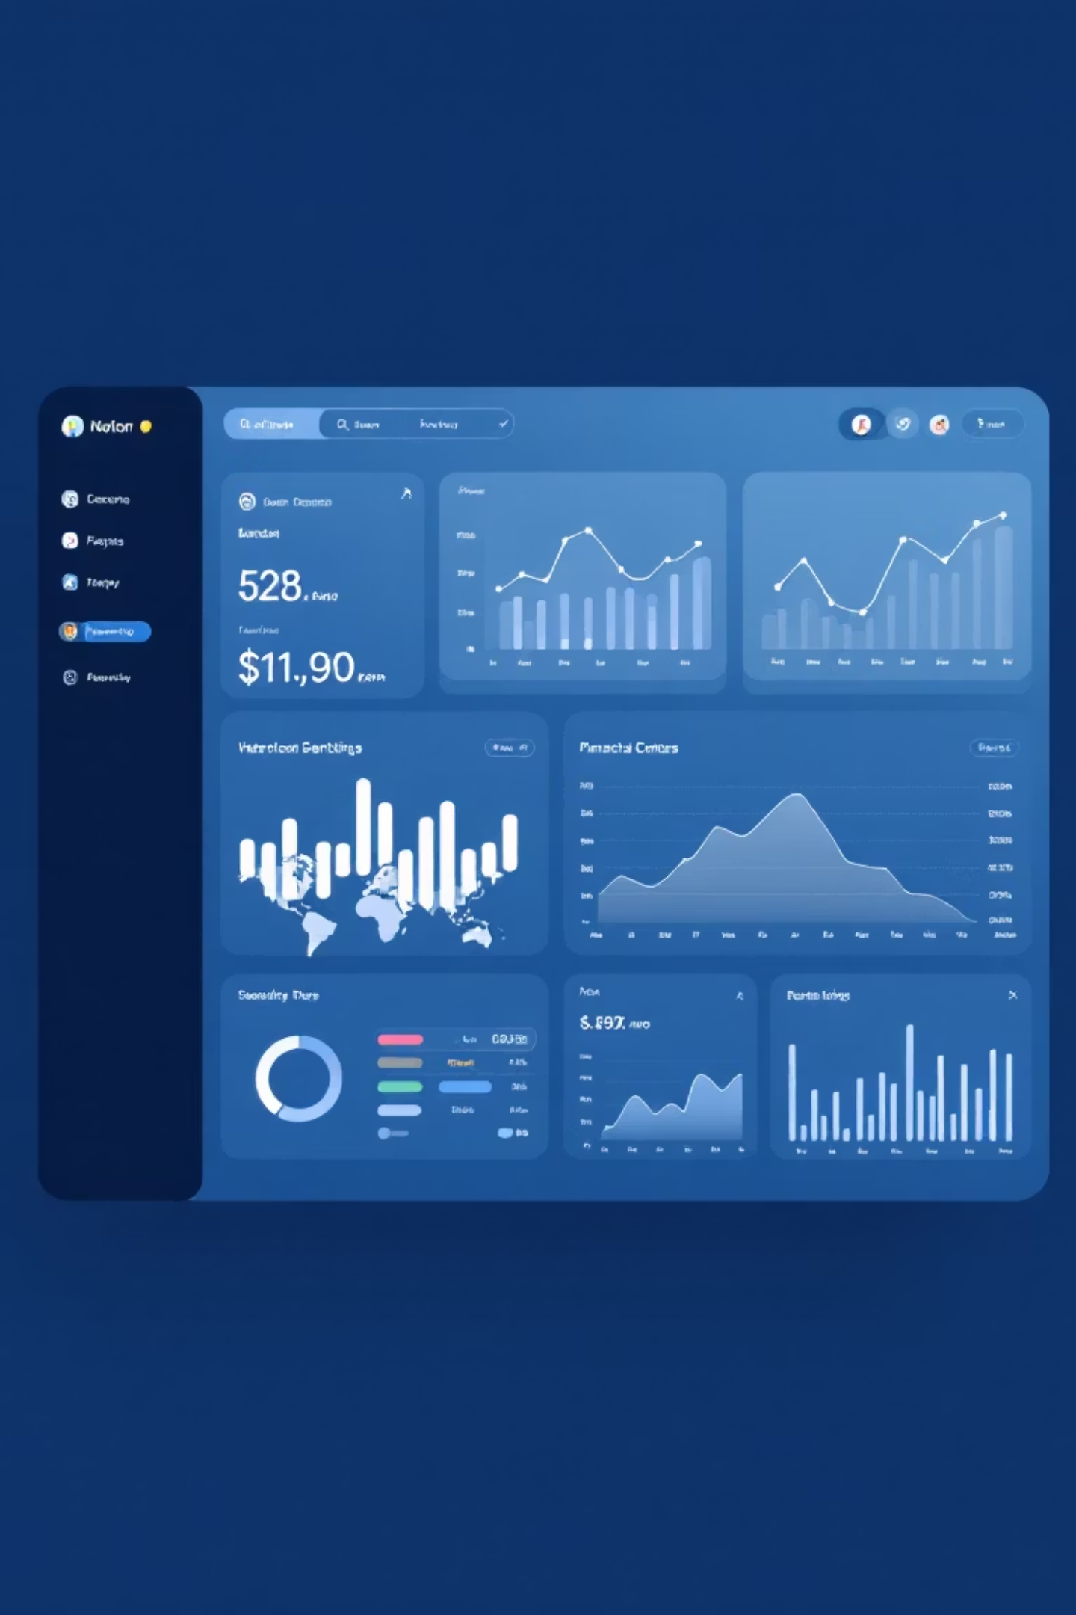
Customer Credit Risk Analysis
Identifying factors contributing to customer credit risk and analyzing behavior patterns of credit-worthy versus credit-risky customers in banking and finance.

Slide 2

Dataset Overview
Customer Demographics
Payment Transactions
Encoded categorical features with risk labels identifying customer profiles.
Overdue history, account balances, and credit limits tracking payment behavior.
Credit Worthy (Label 0)
Credit Risky (Label 1)
Customers demonstrating responsible credit behavior and timely payments.
Customers showing patterns of payment issues and elevated default risk.

Slide 3
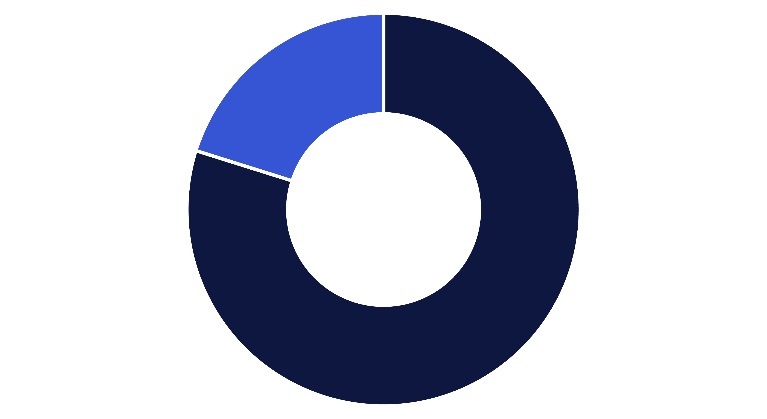
Customer Risk Distribution
Credit Worthy
Credit Risky
The dataset shows an imbalanced distribution with 80% credit-worthy customers (900) and 20% credit-risky customers (225). This reflects real-world banking scenarios where risky customers are fewer but represent critical business concerns requiring focused attention.

Slide 4

Payment Behavior Aggregation
Transaction data aggregated at customer level to capture comprehensive behavior patterns and reduce noise.
Overdue Frequency
Payment Patterns
OVD_t1, OVD_t2, OVD_t3 tracking severity levels and total overdue days.
Normal payment behavior frequency indicating customer discipline.
Credit Metrics
Credit limits and balances revealing utilization patterns.

Slide 5


Overdue Behavior Analysis
1,152
2,274
2x
Credit Worthy
Credit Risky
Risk Multiplier
Average overdue days for responsible customers
Average overdue days for high-risk customers
Risky customers show nearly double the overdue duration
Key Insight: Overdue history emerges as a strong risk indicator, with credit-risky customers accumulating almost twice the overdue days compared to credit-worthy customers.

Slide 6
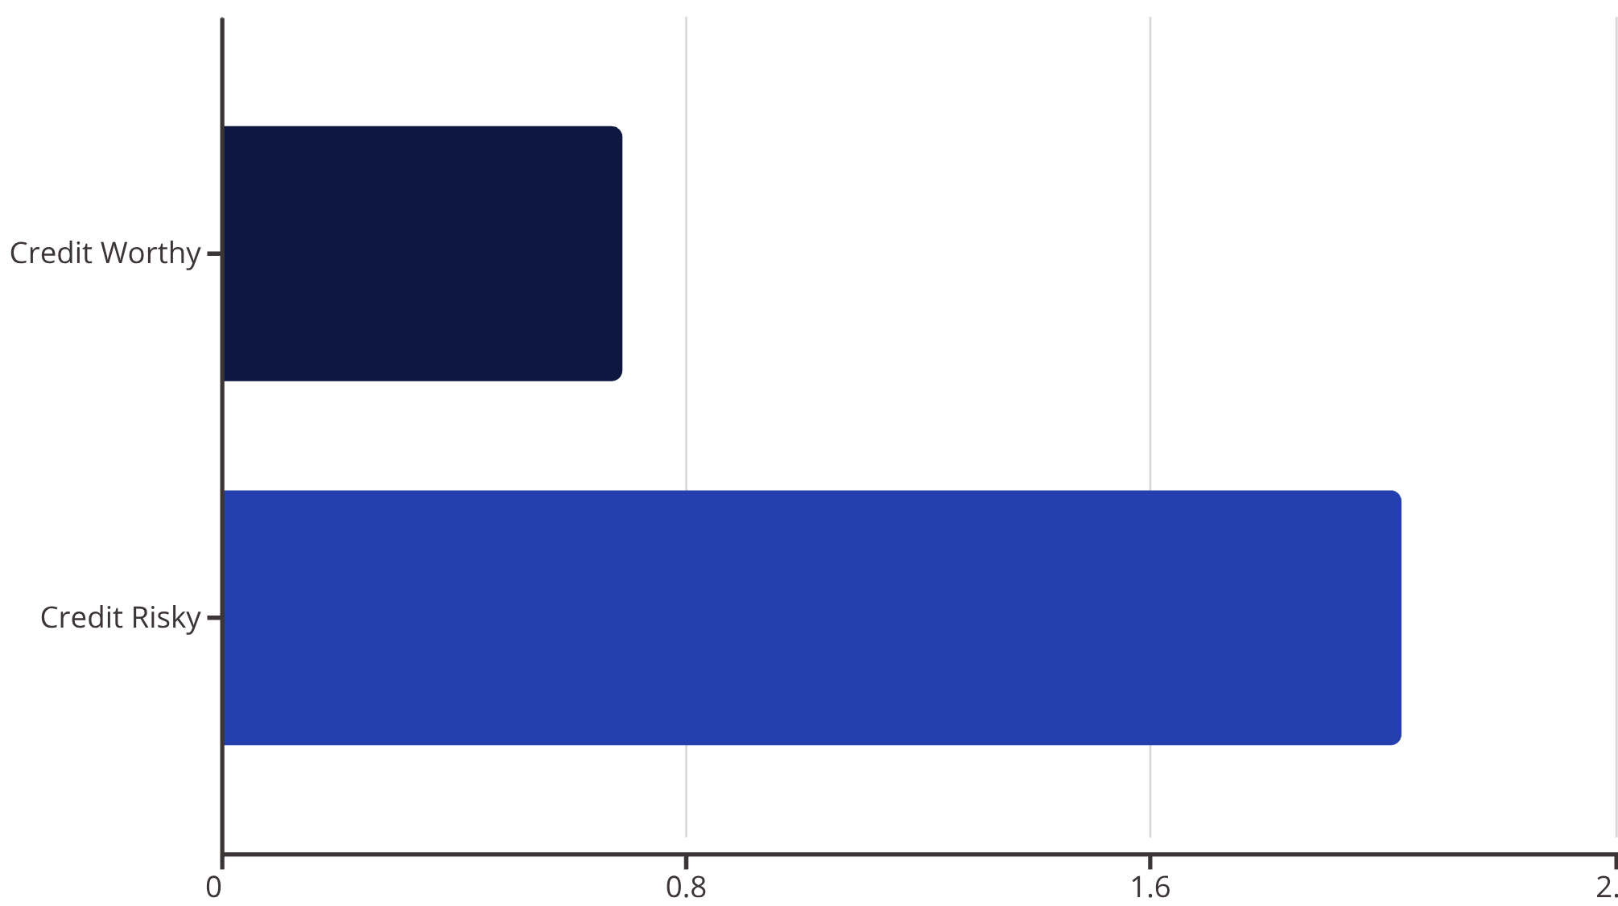
Credit Utilization Patterns
Critical Finding
Risky customers exceed their credit limits on average, with utilization above 100%.
High credit utilization (>100%) strongly correlates with default risk, making this a key predictor of credit risk.

Slide 7


Payment Discipline Comparison
113
79
Credit Worthy
Credit Risky
Average normal payments demonstrating consistent discipline
Average normal payments showing irregular patterns
Credit-worthy customers make significantly more on-time payments, while risky customers exhibit irregular payment patterns and lower payment frequency, indicating poor financial discipline.

Slide 8
Overdue Type Severity Analysis
Risk Label
OVD_t1
OVD_t2
OVD_t3
Credit Worthy (0)
1.69
0.79
2.37
Credit Risky (1)
2.38
1.51
4.04
Risky customers show higher severity and frequency across all overdue event types, with OVD_t3 (most severe) nearly doubling compared to credit-worthy customers.

Slide 9

Business Interpretation
Credit Risky Customers
Credit Worthy Customers
Over-utilize credit limits
Maintain controlled credit usage
Accumulate long overdue periods
Pay regularly and on time
Miss regular payments
Lower overdue frequency
Exhibit repeat severe delinquency
Stable repayment behavior

Slide 10


Key Takeaways & Business Impact
Credit risk is driven primarily by customer payment behavior, rather than demographics alone.
Key Risk Drivers
Business Applications
High credit utilization
Inform credit approval rules
Long overdue duration
Enable early warning systems
Frequent severe overdue events
Support risk-based segmentation
Poor payment discipline
20%
Risky Customers
Critical segment requiring focused monitoring

